Slide 1
Unit 3: Text-Based Programming
Lesson 6

Slide 2
Variable Naming
When making variables you should follow some general guidelines:
Use a short but descriptive name
You can not command words as functions (ex. print can not be a variable)
https://docs.python.org/3/library/functions.html -> link to built in functions, there are also built in items
Spaces are not allowed
Can’t start with a number
Use lower case separated with underscores (ex. first_name) or use CamelCase (ex. FirstName)

Slide 3
Commenting
You should use commenting to explain what your code is doing.
A # is used for commenting, you may have noticed when you open a new file in Mu that there is a comment in the blank file.
The IDE will not process anything written after a # on a line, so you can put your comment on the same line as a command.

Slide 4
Commenting
Commenting is important, it will be used by others that view your code to explain what you are doing and it is also useful for yourself when you go back to a program that you created in the past to help you remember what you did.
If you are going to write multiple lines of comments then you should use docstrings(example on next page)
You can use commenting or docstrings to give a description of your program at the beginning of the file, before you write any lines of code.

Slide 5
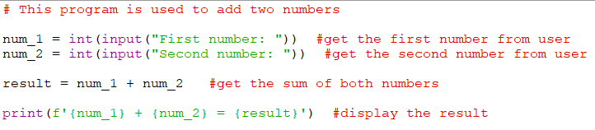
Using # for comments

Slide 6
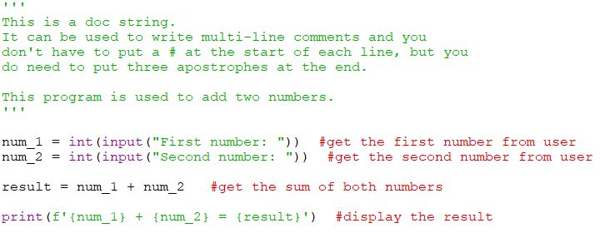
Using docstrings at the start of a program.

Slide 7
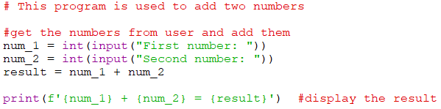
Commenting
From now on you should add comments to all of your projects that you create.
On the first assignment you will be asked to put a comment on every line of code to explain what it does. But after that you can explain sections of your code.

Slide 8
Best Practices
Planning is necessary so you have a clear vision of what you are creating and the general process for building the blocks of code.
Flowchart
Pseudocode
Optimizing code is essential so that it is efficient and requires as few lines as possible (the tutorials are usually longer than they need to be).

Slide 9
Documenting should be practiced within the code to provide details on what the code is doing. Good documentation is essential in all programming projects.
Simplifying code is very important. Keeping code straightforward means there should be less bugs and it will take less time to debug a piece of code when testing.

Slide 10
Collaboration between programmers is a common. You are encouraged to review, comment on and debug each others code. Getting someone else to test your program can often expose errors that you may not have thought of.
This does not mean you share your assignment with another student so that they don’t have to do any work.

